Slide 1
Capstone Project EDA Airbnb Bookings Analysis

Slide 2
Introduction.
Since 2008, guests and hosts have used Airbnb to expand on traveling possibilities and present a more unique, personalized way of experiencing the world.
Today, Airbnb became one of a kind service that is used and recognized by the whole world.
Data analysis on millions of listings provided through Airbnb is a crucial factor for the company.
These millions of listings generate a lot of data - data that can be analyzed and used for security, business decisions, understanding of customers' and providers' (hosts) behavior and performance on the platform, guiding marketing initiatives, implementation of innovative additional services and much more.

Slide 3
General overview of dataset.
This dataset has around is mix between categorical and numeric values.
Price is a dependent column.
Total 16 columns are present in the dataset.
Total observations are 48895.
Min of Price variable is 0, max is 10000$.
Mean price is 152$
On an average people stay 7 days in a room.
75 Percentage of times minimun neights stayed is 5.
Mean reviews given to Room/apartment is 23.

Slide 4
Missing value Handling.
‘name’ = 16 null values.
‘host_name’ = 21.
‘last_review’ = 10052.
‘reviews_per_month’ = 10052
‘name’ column we will replaced the ‘nan’ values with corresponding ‘room_type’ values.
‘host_name’ will not use as those are names of individuals.
'reviews_per_month' we will replace with 0 for NA values.
In ‘last_review’ We will convert its data type to catogorical and replace 'NA' with 'never'.

Slide 5
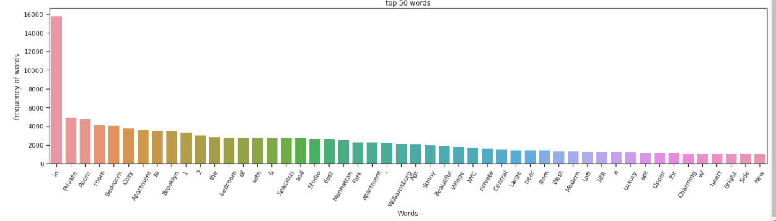
Top 50 words form Word_Cloud:

Slide 6
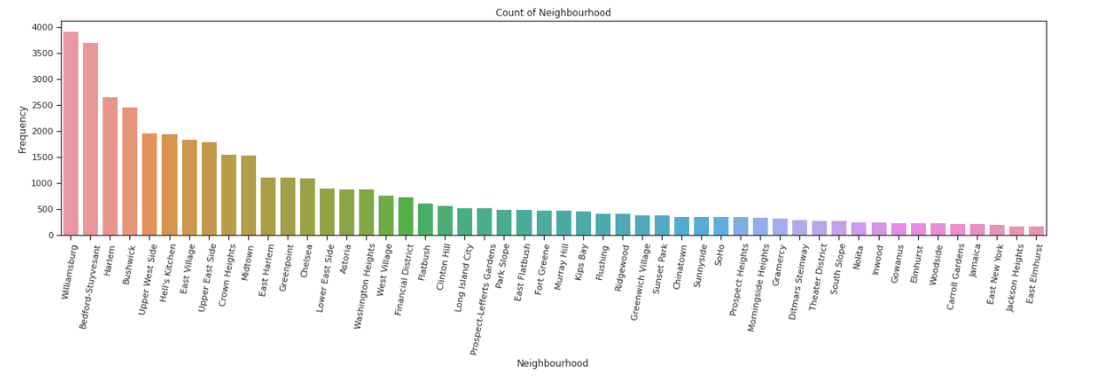

Count Of Neighbourhood :

Slide 7
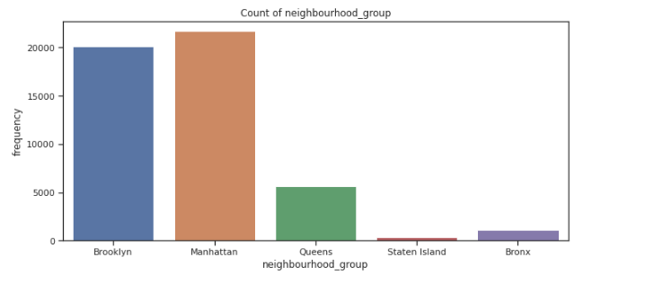
Count Of Neighbourhood Group :

Slide 8
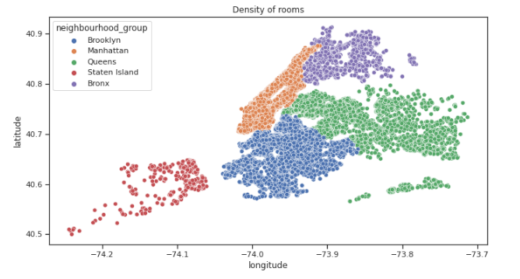
Longitude & Latitude

Slide 9

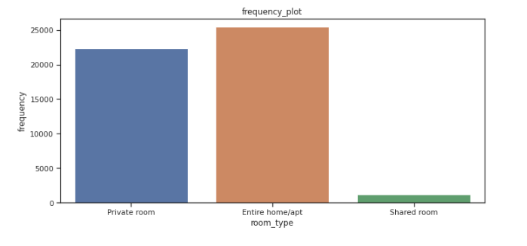
Room Type
Observations:
1.There are three types of rooms
2. Namely:
1.Private room
2.Entire home/apt room type
3.Shared room.
3.People mostly preferred to take
whole apartment on rent
followed by Private room.
4. very few people preferred to
have shared rooms.
We will try to categories the 'price' like cheep, affordable and expensive and then analyze the 'price' for 'room type' as per it.

Slide 10

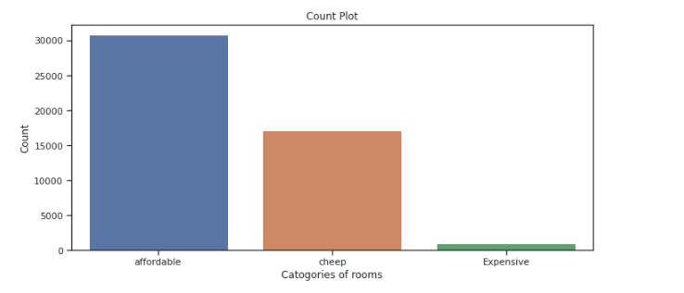
Check The Price Range
cheep (price range below or equal to 80$)
Affordable(for price range 80 to 500$)
Expensive(for price range more then 500$) so, it look like people have more interest in having "affordable" rooms/apartments rather then having cheep and expensive rooms.

Slide 11
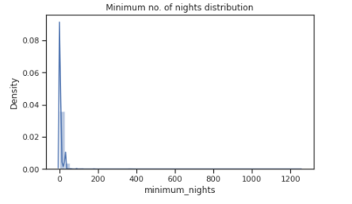
Minimum No Of Nights Distribution
Observations
1. Average booking is around 7 nights.
2. minimum booking is for 1 night.
3. max booking is for more then a year or we can say for few years.

Slide 12
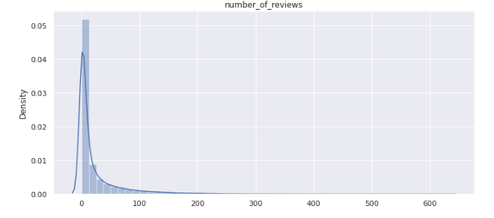
Number Of Reviews
Observations:
Number of reviews are highly dense form 0 to 100 reviews.
we can say that most of the rooms are not rated and those which are frequently occupied only those are rated.
maximum 629 times the particular room is rated.
Average rating is around 23.

Slide 13
column_no_9 calculated_host_listings_count
Most_common 50 host_listing_count
There is one host who is 327 time listed.
This is the corresponding host_id 219517861 who is having highest listing.
This is the corresponding host_id 15400695 who is having lowest listing.
_Review
max is 58 times the rating is given.
min is 0.
75% of data is for 1.5 time rating.

Slide 14
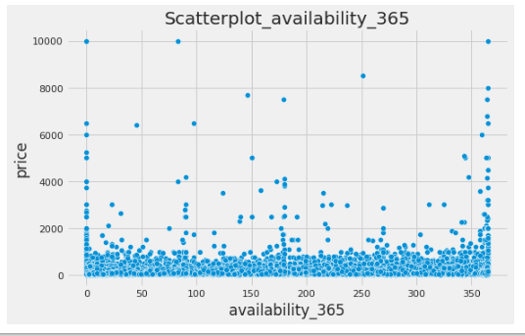
Availability_365
Observations:
1. From above plot we can see that most of the available rooms are in the prose range of 0 to 2000.
2. Very few are available for price above 2000$,this is quite oblivious that there are very few peoples
who prefer to have expensive rooms.

Slide 15

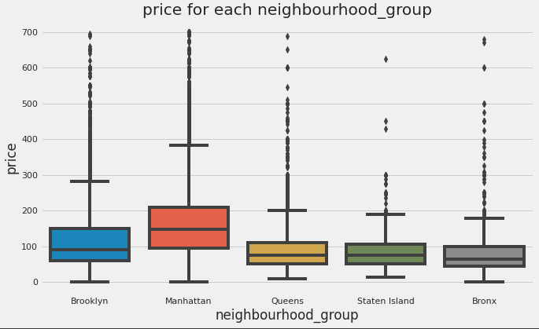
Lets find the relation between neighbourhood_group and price:

Slide 16
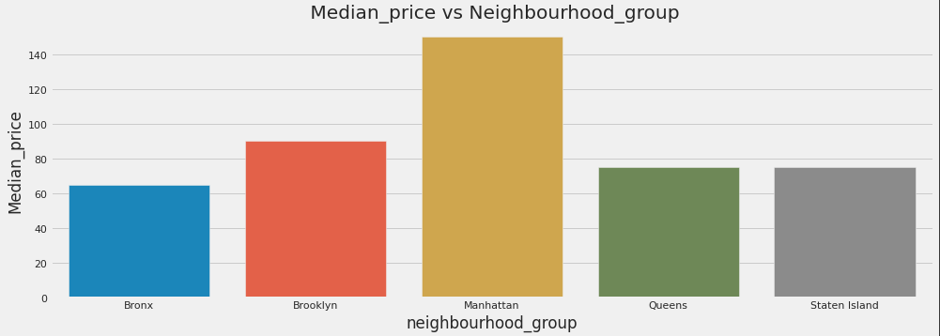
Relationship Between Neighborhoods Group And median price.

Slide 17
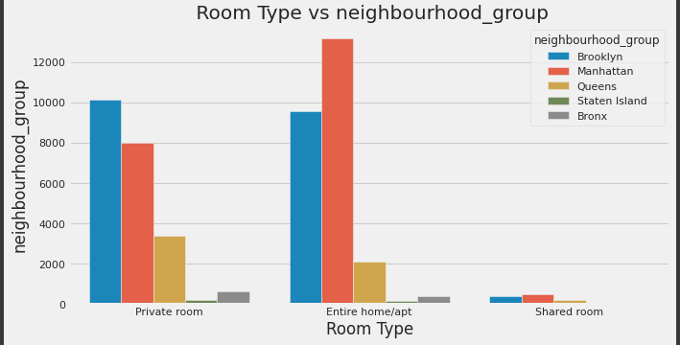
Relationship Between Room_Type And Neighbourhood_Group.

Slide 18
Conclusion: We tried to put some light by performed the Extensive EDA for Airbnb dataset as always there is no end to EDA this can be extended in n- dimenssions and lots and lots of conclusion can be drawn from EDA this is where 80% of time is been spent by and Data Scientist.
Thankyou

